Slide 1
QLeapTM
(Company 4)
Take a Quantum Leap Forward
CEO, SARRAZIN Alban
COO, BIN MOHD NOOR Ku Muhammad Hafiq
CMO, SFAXI Malek
CFO, ROBERT Brice, Setra
Notes:
add theme Name of the Company
Company number in simulation
Name of team members
with their function(s) (CEOs, CFO, …)
in the order they will present
CEO, SARRAZIN Alban
COO, BIN MOHD NOOR Ku Muhammad Hafiq
CMO, SFAXI Malek
CFO, ROBERT Brice, Setra

Slide 2

“ Our mission is to lead the industry towards a more sustainable future by delivering innovative solutions and minimizing environmental impact.
With QLeapTM
Take a Quantum Leap Forward
“

Slide 3
Outline

Slide 4
Outline
Objectives
investments
Research & Development
Inventory
Production
B2B Partnerships
Marketing strategy & Consumer Sales
Finance
Our Future

Slide 5
Objectives
Maintain our Activity
Stay the leader Chip producer
Keep improving our products to match our innovative spirit
Diversify the company’s activity
Start B2C sales, operate in several areas
Start production of PCs
Gain the status of Wholesaler

Slide 6
28.9M CHF Total Retained Earnings
77 % Average Retained Earnings Growth
1.5M CHF Dividends to Shareholders

Slide 7
Operations

Slide 8
Investment
8.08M CHF Total Investment in plant acquisition
4.4M CHF Royalty gained
800K USD Spend in method improvement
Notes:
COO
with the total of 4 p
3 chip plant
1 pc plant
both in US
Royalty obtained from patent leasing to another company
currently what we have obtained so far.

Slide 9
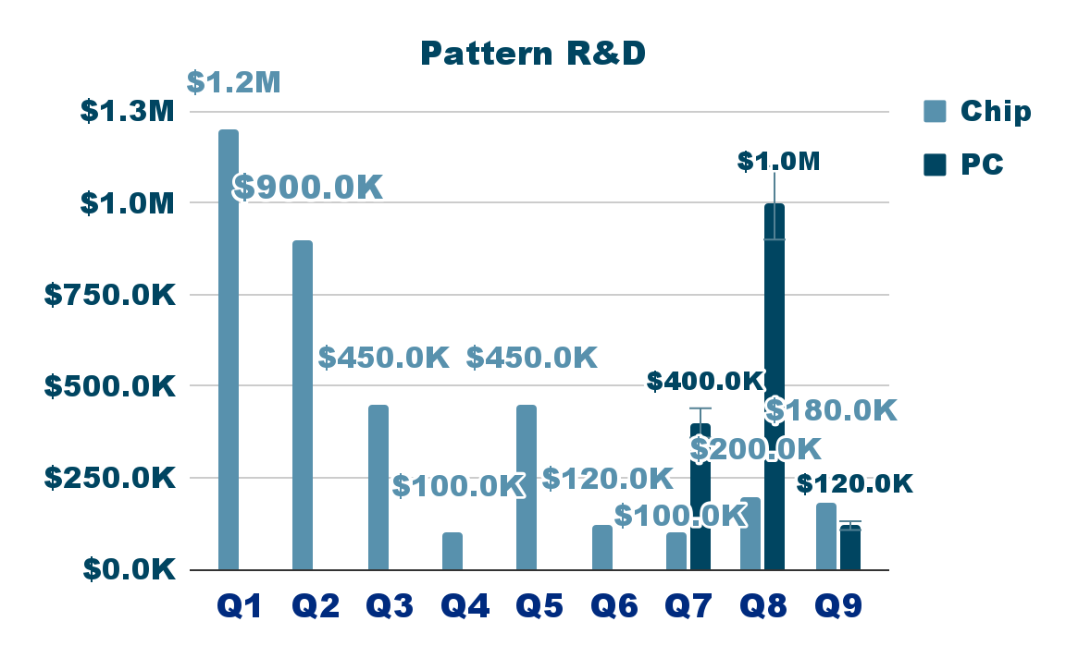
Research & Development
5.2M CHF Contribute in R&D Patenting
2 Co Patent lease 3 quarter & more
X5 & Y1 Patent Obtained
Notes:
COO
-Align with our objective, we maintained ahead than any other company that obtained such patent
-We able to acquired partnership with other company to lease our patent
-with that total money invest in patent, we manage to obtained such patent

Slide 10
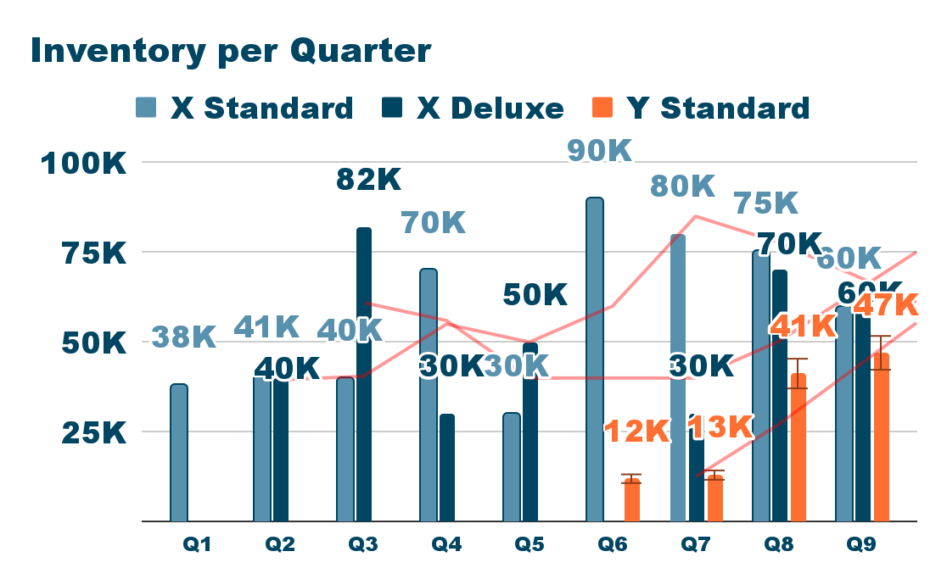
Inventory
Q1-Q9 Availability
28K PC Average start Q6
55K Chip Average maintained per quarter
Notes:
COO
-As a chip & pc producer, we able to maintained our production rate each quarter. even that is slightly drop in between q4 and q6 due to chip price rise.
-We manage to get in hand of PC starting from Q6 even we are new in the market for PC demand.
-with the total of 3 chip factory, we are able maintain in our inventory of 55k chip each quarter
Total Ending Inventory
X
Standard: 524K
Deluxe: 362K
Y
Standard: 113K

Slide 11
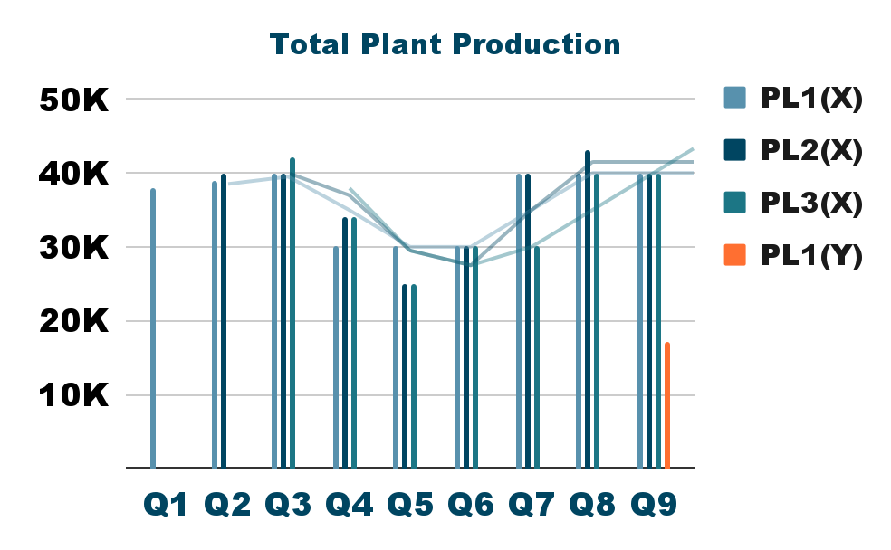
Production
109K Chip Average produce per quarter
877K Chip Total Produce
4 Plants Built
Notes:
COO
Never not produce, always produce. and sold
-

Slide 12
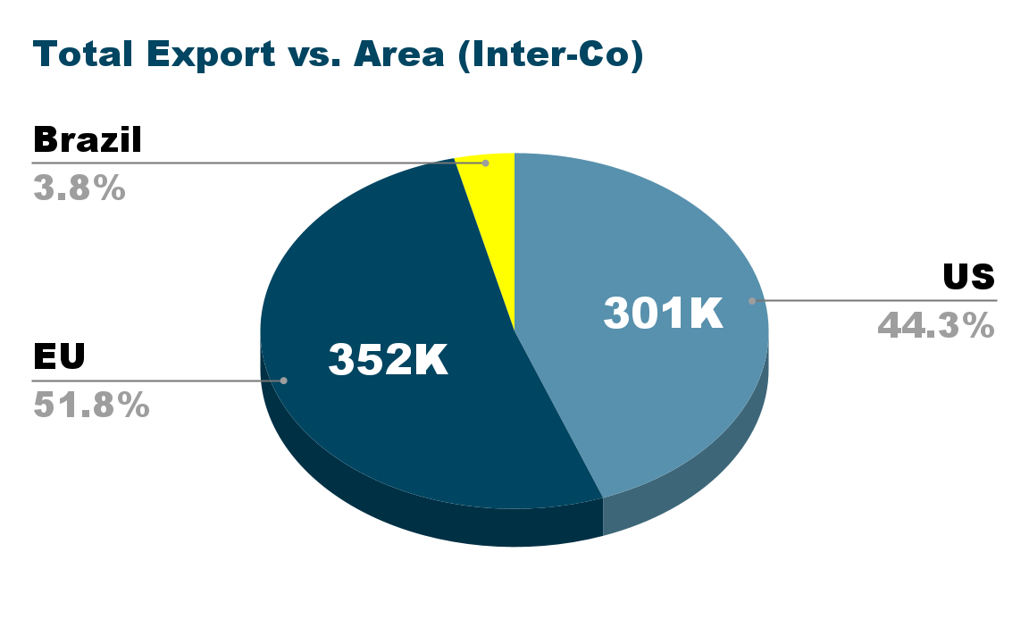
Companies Partnership
11 Contracts Signed & Delivered
679 K Chip Total Export
3 Quarters Plus
Notes:
COO

Slide 13
Marketing

Slide 14
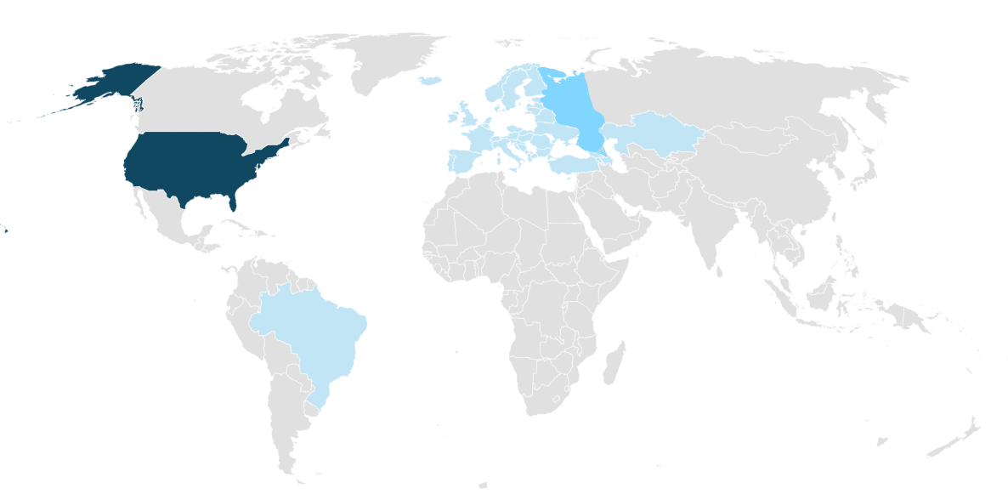
Consumer Sales (1)
Factories In The US
Wholesaling In EU & Brazil
55K PCs sold
23K Chips sold
25K PCs sold
20K Chips Sold
Notes:
43K Chips sold B2C
80K PCs sold B2C

Slide 15
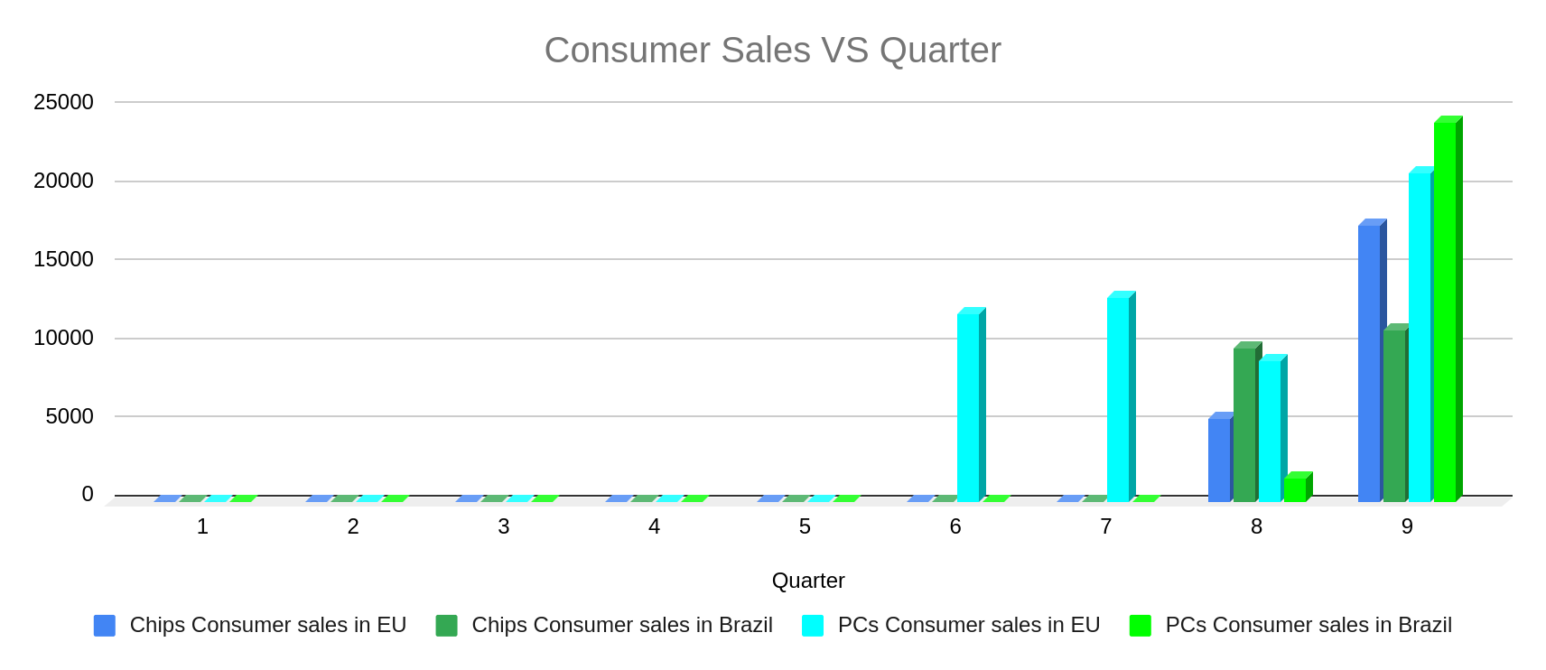
Consumer Sales (2)
Wholesaler Status in EU & Brazil
Focus on B2B Sales

Slide 16
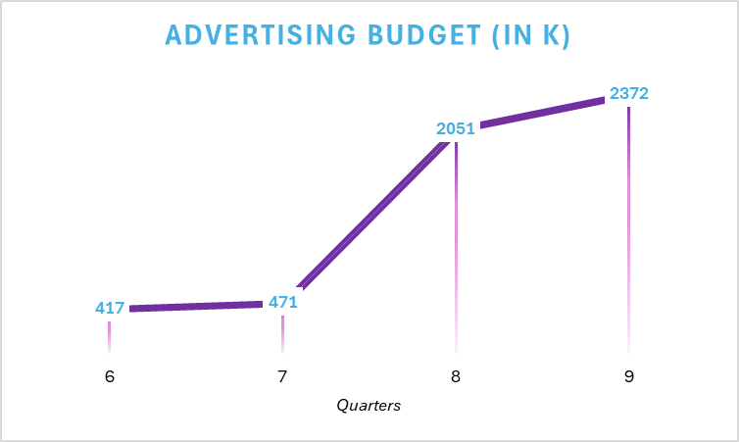
Advertisement
Defining it as 6% of Expected Sales

Slide 17
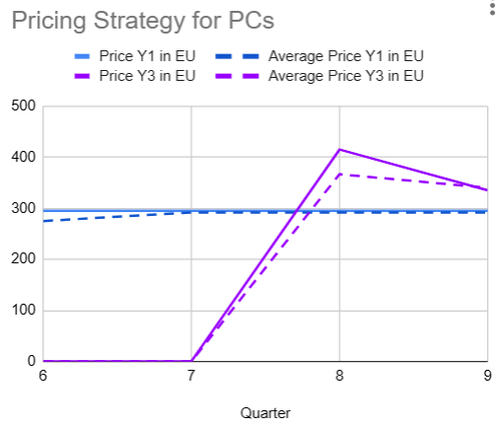
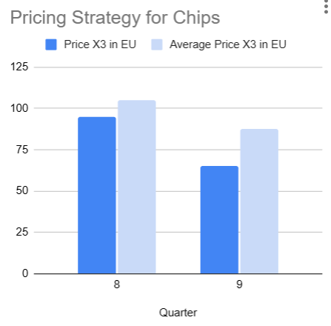
Marketing Strategy : Pricing Strategy in EU
+ X1 at 30€

Slide 18
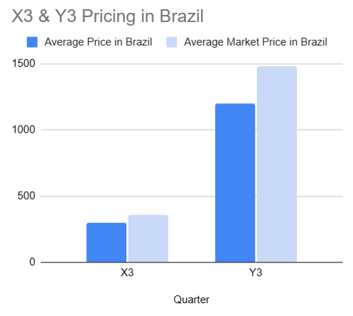
Marketing Strategy : Pricing Strategy in Brazil
"High Volume, Low Margin" to maintain Customer Loyalty
The only seller of X4 in Brazil

Slide 19
Average Market Shares in EU & Brazil
30% for PCs
65% for Chips
16% for PCs
48% for Chips

Slide 20
Performance Measures

Slide 21
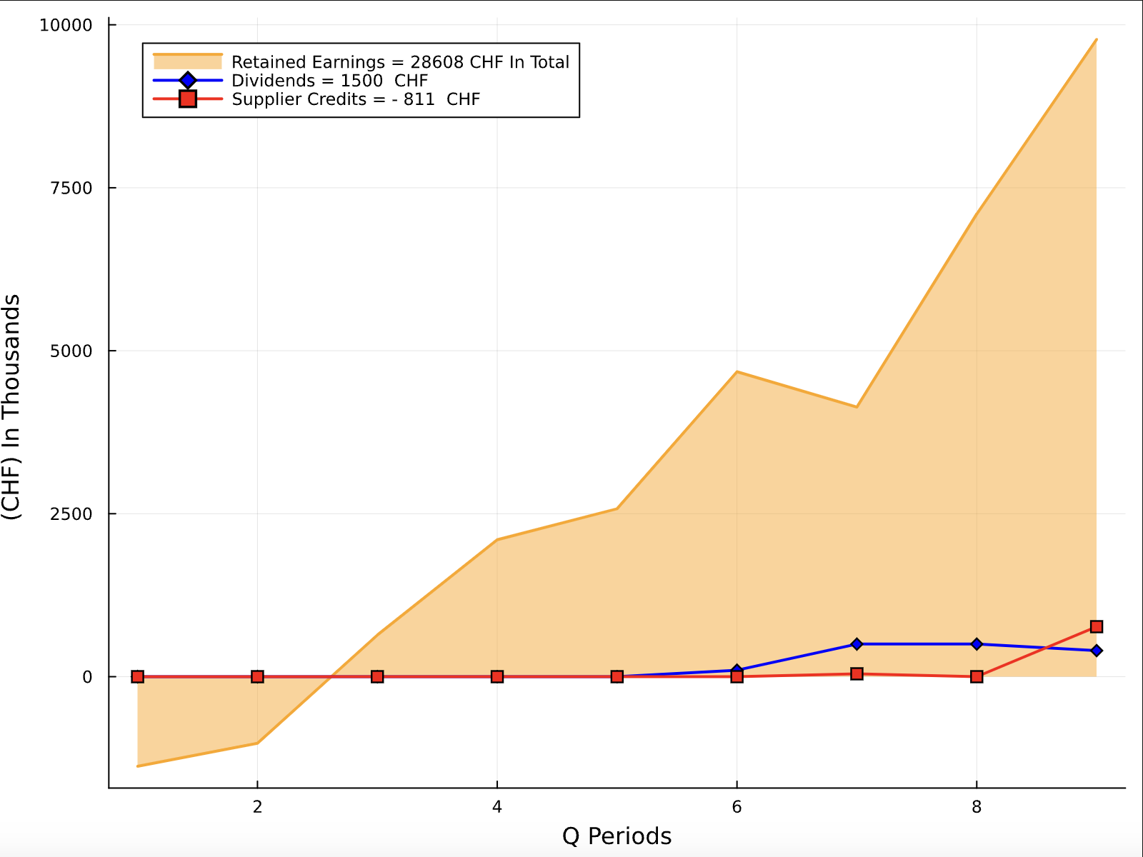
Financial Figures
Key Metrics
High Retained Earnings:
Initial investment in Q1 was 20M CHF
Redistribution
Dividends:
Rewarding shareholders will be increased
Notes:
CFO

Slide 22
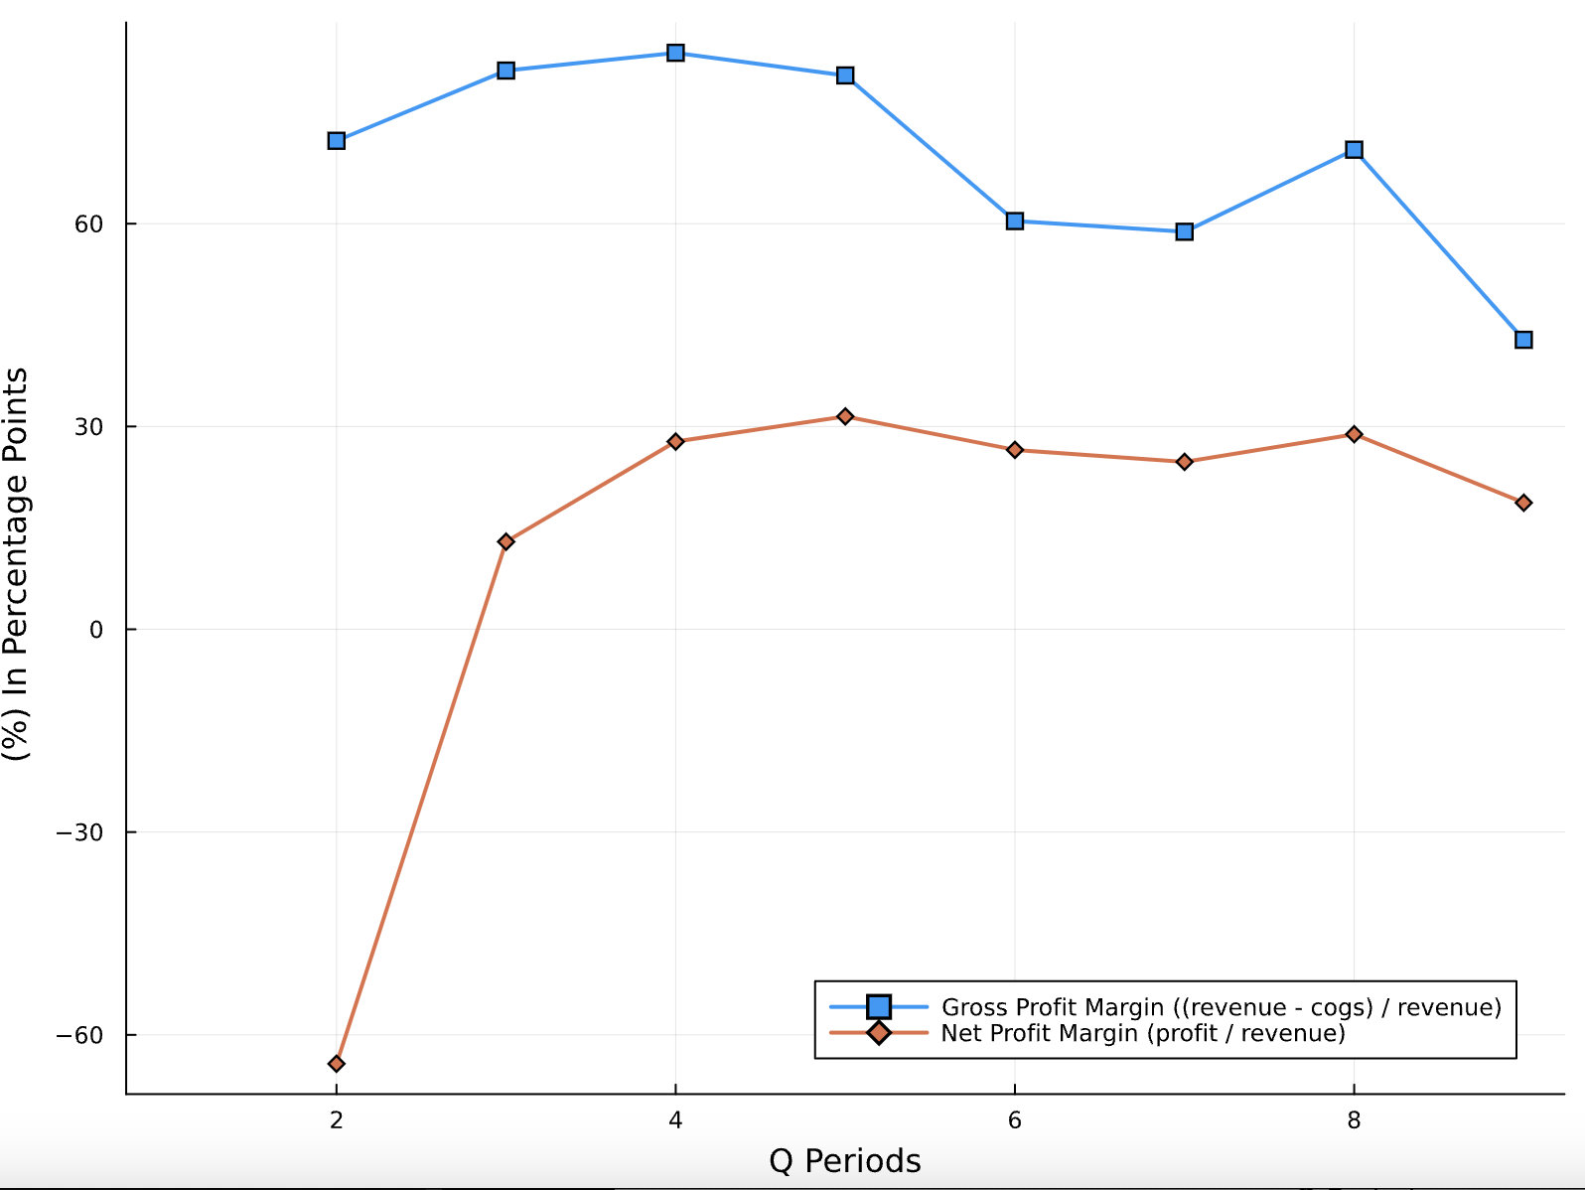
Financial Indicators
Profitability Metrics
Gross Profit Margin:
Efficiency of production and pricing strategies.
Net Profit Margin: bottom-line efficiency.
Leverage Ratios
Debt-to-Equity Ratio:
No need to calculate since the company was fortunate enough to avoid borrowing money

Slide 23
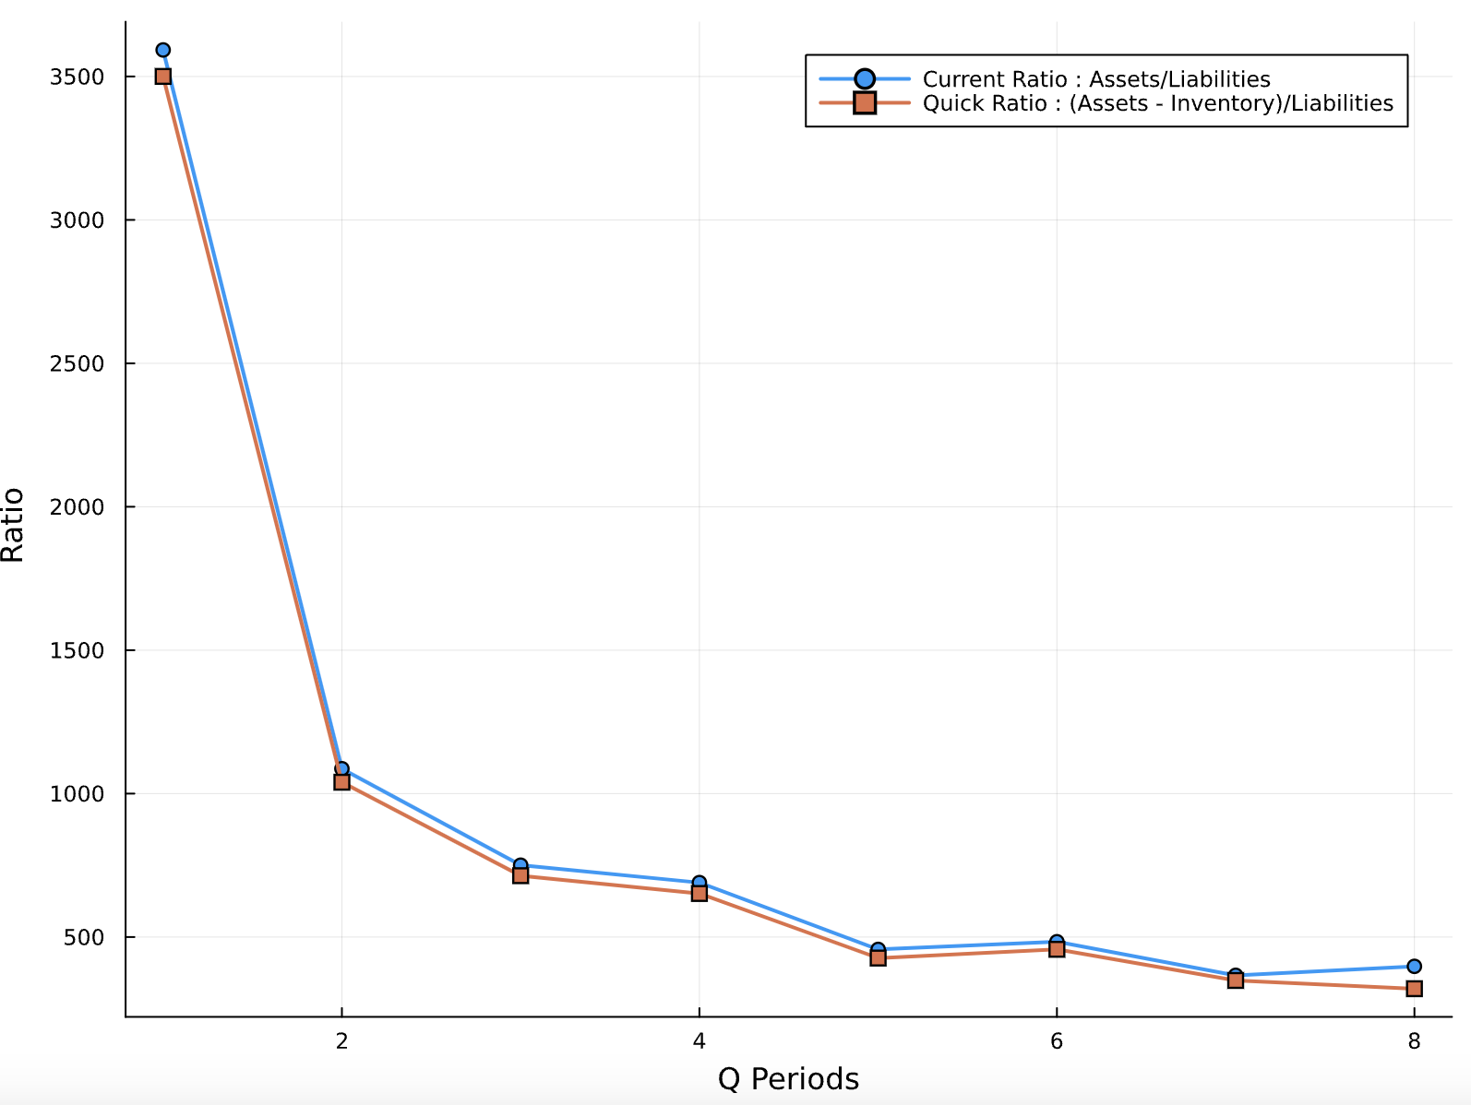
Financial Indicators
Liquidity Ratios
Current Ratio:
ability to meet short-term obligations.
Quick Ratio:
stringent measure of liquidity.
Valuation Multiples
Price-to-Earnings Ratio (P/E):
Discussion for introduction of the company to going public

Slide 24
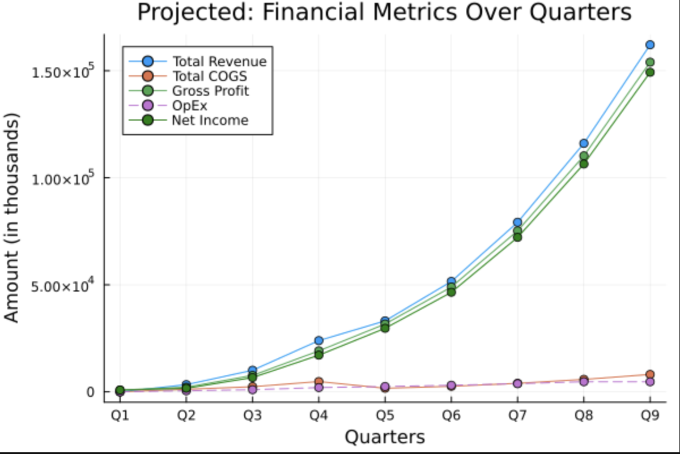
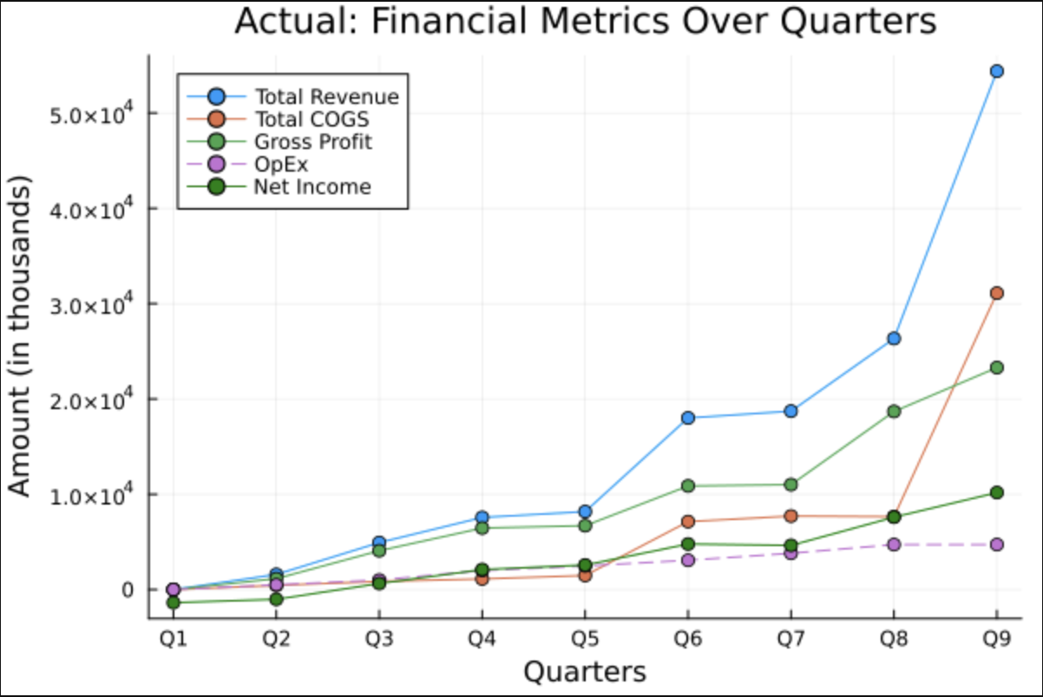
Projected vs. Actual
Key Metrics
Revenue Projection Curve on target:
estimation growth will be adjusted.

Slide 25
Future

Slide 26
Future Plans
Improve our Goodwill with client by building and expanding our Identity
strengthen our partnerships
Keep improving continuously the quality of our products
Increase our profitability
Be present in all steps of the value chain
Worldwide Expansion : QLeapTM invading worldwide markets
We are delighted to propose the first 100% QLeapTM made PCs starting next quarter

Slide 27

With QLeapTM
Take a Quantum Leap Forward
Visit our Website
Notes:
if any

Slide 28

Appendix
Notes:
if any

Slide 29
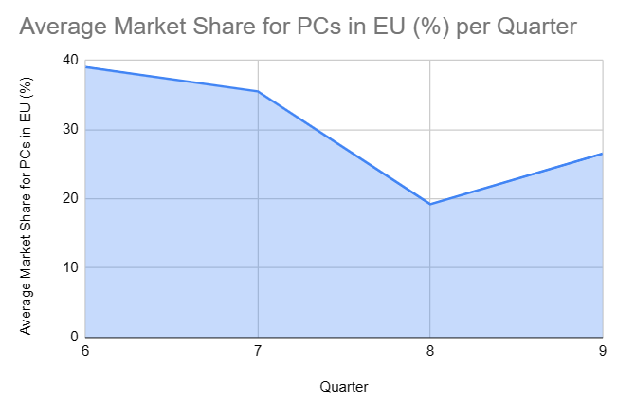
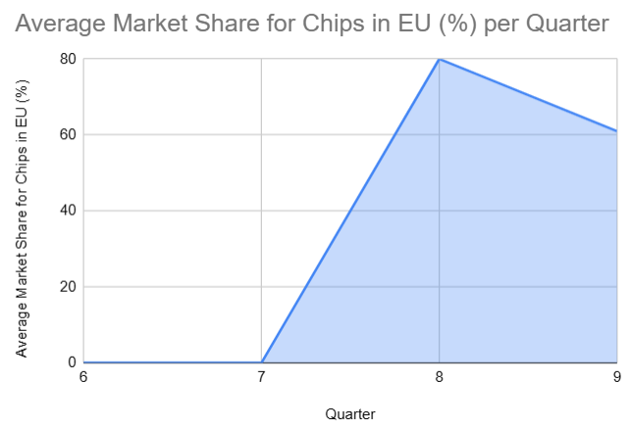
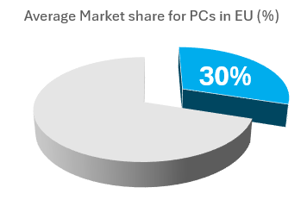
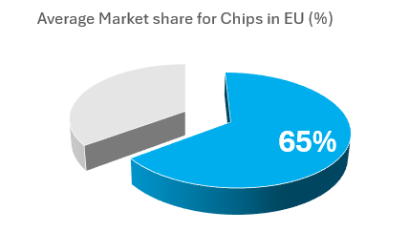
Market Shares in EU

Slide 30
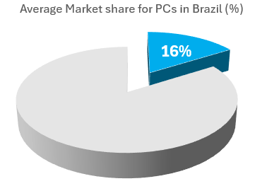
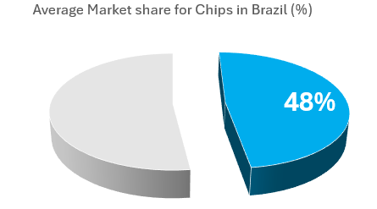
Market Shares in Brazil

Slide 31
Gap Analysis vs. BP2
Factor | Achieve | Not Achieve
Technology | Secured a higher grade of Chip & PC Pattern | Market demand for higher grades was insufficient, hindering the utilization of the current patterns obtained
Production | Maintained optimal production standards | Unable to achieve maximum capacity in plant production rates
Market Demand | Successfully expanded into new markets | Failed to meet the targeted sales objectives.
Partnerships | Secured long lasting partnerships with several companies | Failed to keep all our partnerships alive, some companies choose to go produce themselves, sell directly to consumer or did not select us for consumer sales.
Notes:
We did not achieve what we planned because:
• Factor 1
• Factor 2
• Factor 3
Sales out at the end : (we just obtained the salewholer status at the end, so we miscalculated the sales quantities, but it is a good thing since it highlights our market potential. Moreover, even before becoming wholesaler’s we had the largest shares of the market
We succeeded to reach our objectives because:
• Factor 1
• Factor 2
• Factor 3

